Slide 1
2012 Review & 2013 Preview
Monday | Tuesday | Wednesday | Thursday | Friday
31 NEW YEAR’S EVE | 1 NEW YEAR’S DAY | 2 | 3 | 4 Supervisors reach out to employees and staff for self- and 360 evaluations.
7 | 8 | 9 | 10 | 11 Employee self-evaluation and staff 360º evaluations due to supervisors.
14 | 15 | 16 | 17 | 18 Supervisors complete draft evaluations and goals + schedule meetings with staff to discuss drafts.
21 MLK HOLIDAY | 22 | 23 | 24 | 25 Supervisors make final revisions to evaluations and goals.
28 | 29 | 30 | 31 Final evaluations and goals due to President’s Office for final approval. | 1 Annual Review/Preview (Staff Retreat) Draft 2013 Unit Goals Due

Slide 2
Required Documents
Employee 360º Self-Evaluation
Copy of 2012 Performance Goals
*If individual goals for 2012 were not established, you may include a copy of the unit’s goals instead.
2012 Goals & Performance Evaluation Form, signed by employee and supervisor(s)
2013 Employee Performance Goals & Expectations, signed by employee and supervisor(s)
Optional/If Applicable:
Two (2) 360º Evaluation forms completed by colleagues of employee*
*Supervisor has the choice to include these in the final packet or keep them for his/her own files.
2013 Salary Increase Form, signed by employee and supervisor(s)
Supporting memos or documentation

Slide 3
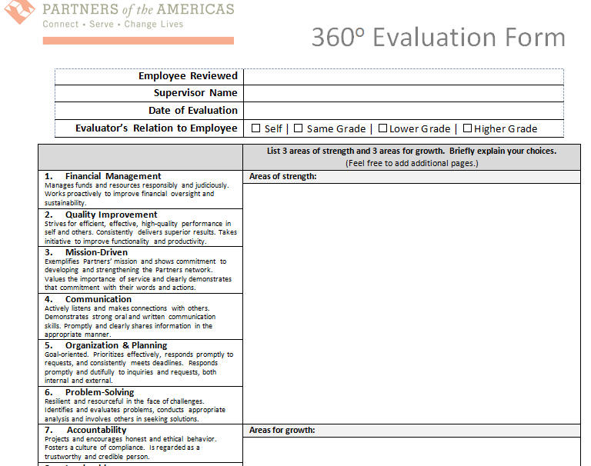
Self & 360º Evaluation
Employee completes 360º Evaluation as self-evaluation
Supervisor requests two (2) confidential 360º Evaluations from colleagues of each employee

Slide 4
2011-2013 Strategic Plan
Build a Financially Sustainable Organization
Ensuring that Partners remains strong and influential is our top priority.
We all must make the necessary effort and time investment into sustaining Partners mission and strengthening our capacity to be financially independent.
The goal here is to “hold and expand” our core activities in areas such as Youth Engagement and in programs like A Ganar, Farmer to Farmer and the various professional leadership exchanges that we manage with the Department of State.
At the same time, all must put a renewed emphasis on putting the infrastructure in place that will allow Partners to capitalize on new opportunities and develop unsolicited proposals in which we can champion new ideas that leverage the talent of our growing network of volunteers and affiliated institutions.
Strengthen Our Network
The core strength of Partners has always been its ability to connect individuals and organizations across the hemisphere and amass a network that is greater than the sum of its parts.
Today we are creating a revitalized network of volunteers, civil society organizations, businesses, universities, governments and collaborators of all forms.
We need to place renewed emphasis on learning and educating ourselves about the many ways to position Partners.
We are in a new era and need to be learning-ready, proactive, and able to make connections and collaborate meaningfully across program areas.
Create an Accountable and Transparent Organization
Partners must continually nurture its relationship with donors, grant-writers and all those who support our mission.
To inspire trust and confidence in our operations, it is imperative that Partners create a climate of transparency and accountability, in which contributors can freely access financial and programmatic information.
Through clean audits, an efficient governance structure, on-time submissions of quarterly and annual reports, improving donor communication, and attaining BBB certification, Partners will be able to ensure supporters that their contributions are wisely invested and buttress our reputation among competitors and members alike.

Slide 5
Rating Scale & Definitions
Rating Definitions
5.0 Exemplary
Consistently achieves at a high level. Exceeds expectations.
4.0 – 4.5 Solid Performance
Consistently achieves above the satisfactory level. Meets all expectations.
3.0 – 3.5 Satisfactory
Accomplishes the task in a satisfactory manner. Meets most expectations.
1.5 – 2.5 Needs Improvement
Improvement is necessary to more consistently meet expectations.
0.0 – 1.0 Seriously Deficient
Problems with approach or execution. Expectations are generally not met.
Suggested Increase Scale
Salary increases are based on performance and available funds. The supervisor may suggest a salary increase for each employee based on the scale below. If deviating from this scale, an explanation must be included. Salary increases are ultimately at the President’s discretion.
COLA will not be used as basis for increases this year. For employees that began employment in 2012, their salary increase will be prorated based on total 2012 salary.
Overall score of 4.5 and above
Exemplary (4-5% increase)
Overall score of 3.5 and above
Solid Performance (2-3% increase)
Overall score of 3.0 and above
Satisfactory (1-2%)
Overall score of 3.0 and below*
Needs Improvement (0-1% increase)
*Supervisor must attach list of deficiencies and necessary corrective actions (performance improvement plan).

Slide 6
2012 Goals & Performance Evaluation Form: Section A. 2012 Goals Review

Slide 7
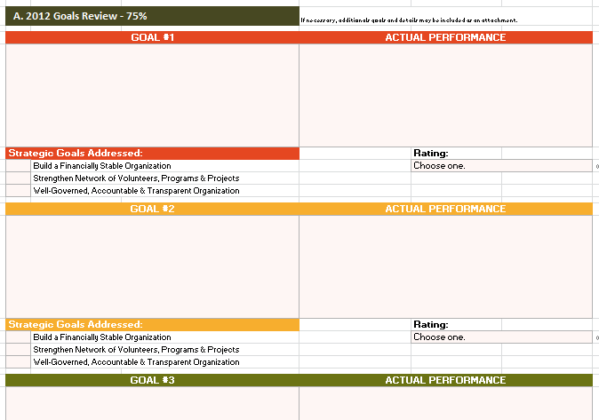
Section A. Counts for 75% of the overall rating
List 3 prioritized goals related to employee’s key job functions or specific role in supporting program/unit goals
Evaluate actual performance based on deliverables established in 2012 Goals (if possible)

Slide 8
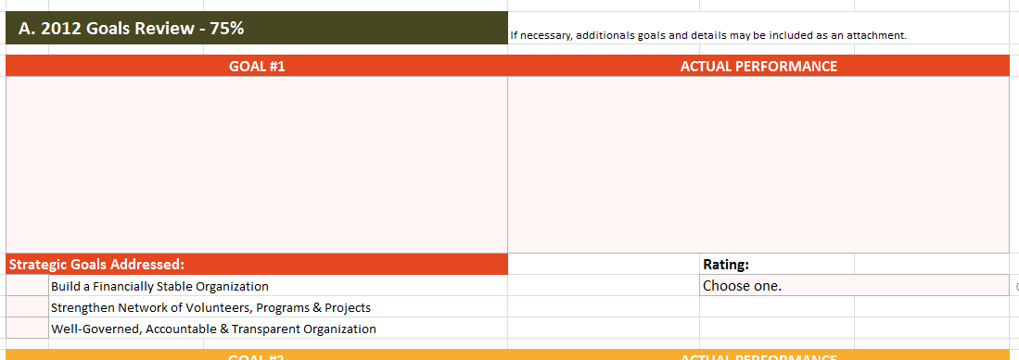
Enter employee’s 2012 goal and objectives (deliverables).
Support improved external communications.
Raise awareness of the program at chapter and outside networking events.
Promote the program through the blog and social media.
Suzy attended 3 conferences and attended chapter events when travelling. Through her networking she fostered a strategic relationship with an important donor. She also greatly increased the program’s social media presence on Twitter and Facebook.
Describe employee’s actual 2012 performance.
Indicate strategic goals addressed.
X
Choose rating.
Note: In using this new format, you will need to adapt the goals from our earlier format to insert in this template. This is the new simplified standard for reporting and evaluating goals that we’ll be using for 2013 and beyond.

Slide 9
2012 Goals & Performance Evaluation Form: Section B. Performance Expectations

Slide 10
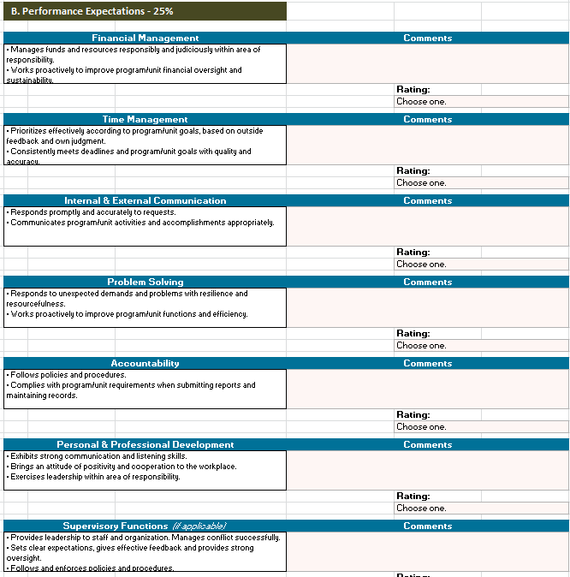
Counts for 25% of overall rating
Financial Management
2. Time Management
3. Internal & External Communication
4. Problem Solving
5. Accountability
6. Personal & Professional Development
7. Supervisory Functions (if applicable)

Slide 11
2013 Performance Goals & Expectations: Section A. Goals & Key Job Functions

Slide 12
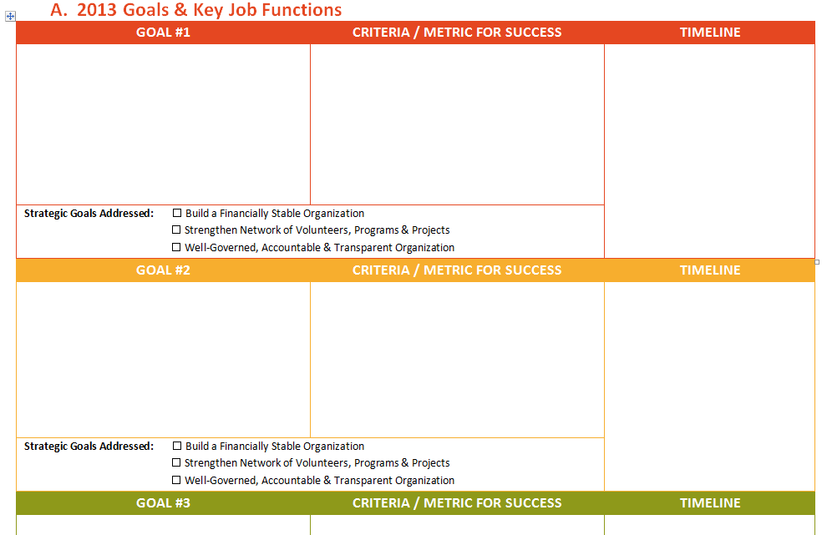
Support continued improvement of external communication and promotion. Raise awareness and foster relationships with donors and key contacts.
Attend at least 5 strategic events, at least 2 within the Partners network.
Create system/database to track communication with chapter leaders, donors and other key contacts.
Represent and promote the program with at least one presentation or publication
Events: Approximately 1-2 events per quarter.
Database: Present plan to team by March. Implementation to begin by August.
Presentation or publication: By the end of the year.
x
x

Slide 13
2013 Performance Goals & Expectations: Section B. Performance Expectations

Slide 14
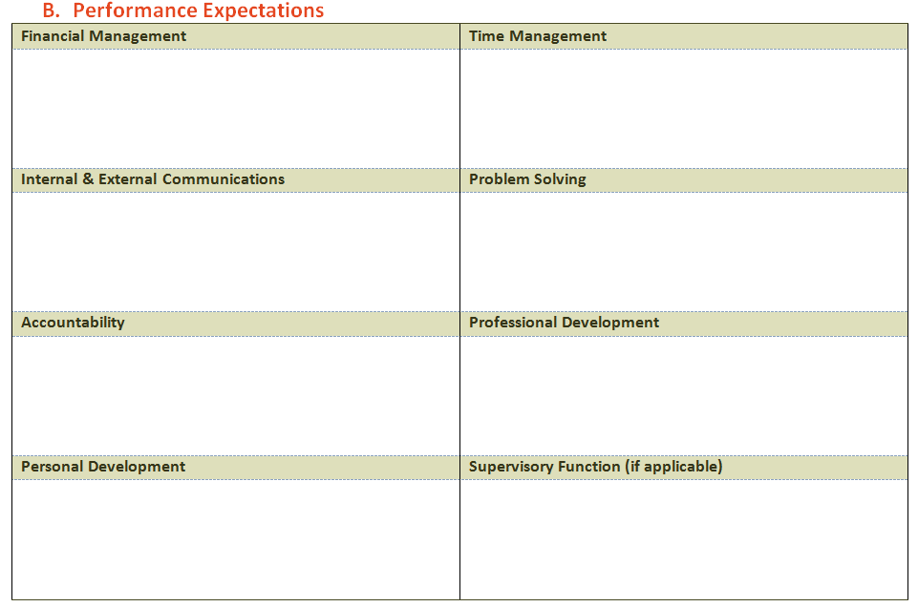
Examples
ALERT – For the 2013-2014 review process, supervisors will be expected to set criteria of performance expectations for their staff
Attend and participate in all monthly F&A meetings.
Learn about budget management and assist
with budget development for proposals.
Ensure individual volunteer placement targets are met each quarter.
Able to prioritize and complete all work in a timely manner.
Provide information necessary for quarterly grant reports to donors.
Inform staff and network of upcoming travel as well as share trip reports as needed
Take initiative to proactively address programs affecting the program and organization.
Follow all grant requirements and organizational policies and procedures.
Encourage transparent and accountable behavior for all team members.
Work with supervisor to take on more leadership and responsibility within the program (see individual 2013 goals).
Improve Portuguese skills.

Slide 15
2013 Program/ Unit Goals

Slide 16
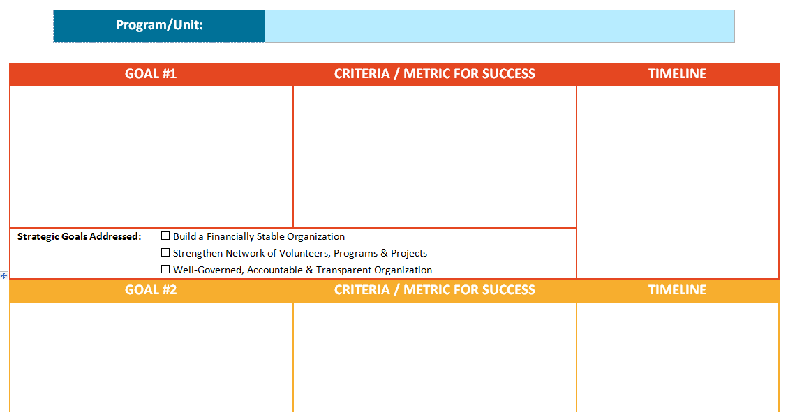
2013 Program/Unit Goals

Slide 17

Questions?

